Slide 1



On – Device Translation of Dynamically Typed and Interpreted Languages
Paper ID : 3334
Authors : Pranav H, Muppavarapu Sri Harshini, Rachuri Tarun, Meena Belwal,
Dept of Computer Science, Amrita school of computing, Bengaluru, Amrita Viswa Vidyapeetham, India.

Slide 2

Table of Contents
Introduction
Existing Methods
Literature Review / Related Works
Methodology
Results
Future Scope

Slide 3
Introduction
There are a varied number of programming languages each having it own processing distinct language and semantics. Developers often need to collaborate and work across multiple programming languages.
In this light the ability to transfer codes from one language to other locally maintaining it’s originality and functionality, will be a key add on and improve collaboration.
MATLAB and Python are programming languages that are widely used for similar purposes, such as data analysis and mathematical modelling, However MATLAB is based on Java and Python is based on C.
Therefore we focused on developing a MATLAB to Python Code Converter to improve synergy between the two languages and allow Python developers to access and use codes written in MATLAB.

Slide 4
Existing Methods
The most commonly used way for translation among different high level programming languages today is exploiting the abilities of various Large Language Models, but this leads to two specific challenges :
The originality of the code, as Large Language Models are by Nature a large mix of various existing works.
The privacy and security of the program as Large Language Models are majorly based on the cloud and the associated risks with it.
Using an On- Device Translator , is an effective and efficient way to address both these concerns and eliminate the fears associated with them.

Slide 5
Literature Review
Sr.No: | Paper Title | Year, Publisher Author’s Name | Inference
1 | Learning Sequential and Structural Information for Source Code Summarization. | Choi, YunSeok, Jinyeong Bak, CheolWon Na and Jee- Hyong Lee. Findings (2021). | Exploring advanced techniques for source code summarization using abstract syntax trees (ASTs) and transformers, integrating graph convolution with transformers to capture both sequential and structural code features, enhancing summarization accuracy
2 | CoTran: An LLM-based Code Translator using Reinforcement Learning with Feedback from Compiler and Symbolic Execution. | Jana, Prithwish, , Piyush Jha, Haoyang Ju, Gautham Kishore, Aryan Mahajan and Vijay Ganesh. (2023). | CoTran is an intriguing approach that leverages feedback from compiler outputs and symbolic execution, it aims to convert code while ensuring both compilation accuracy and functional equivalence. This could be a powerful tool for improving code translation.
3 | ComPy-Learn: A Toolkit for Exploring Machine Learning Representations for Compilers. | Brauckmann, Alexander, Andrés Goens and Jerónimo Castrillón. 2020 Forum for Specification and Design Languages (FDL) (2020): 1-4. | ComPy-Learn is a versatile toolbox designed for analysing diverse program code machine learning representations. Its purpose includes optimizing compiler heuristics and addressing other software engineering tasks. Researchers can use it to empirically explore the most effective representations and models that combine higher-order syntax with low-level compiler information.

Slide 6
methodology
To ensure the translation of MATLAB code to Python code is smooth and does not affect the originality and functionality of the code, there is a need to use a direct and dynamic approach.
This is accompanied with the help of the following modules :
Tokenizer
Lexer
Parser
Code Generator

Slide 7
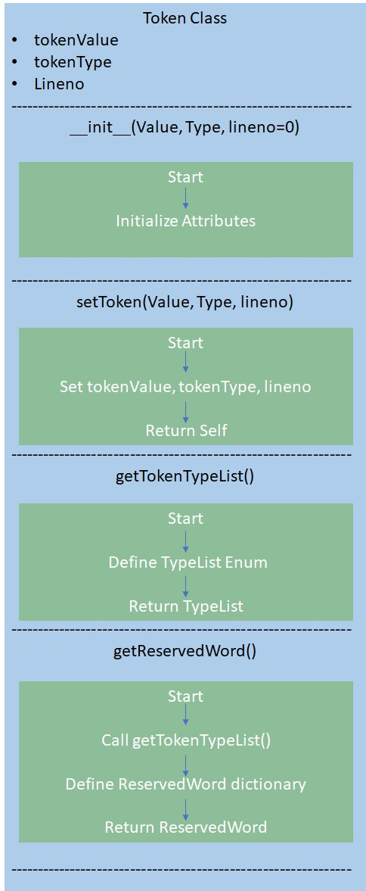
Tokenizer
Initially the tokenizer is used to break the source (.m) files into tokens. This includes static methods for retrieving a list of token types and mapping reserved words to their corresponding types.
The enumeration Token Type categorizes tokens by their role in the language, such as keywords, operators, or punctuation. With this tokenizer, source code can be broken down into meaningful units for better interpretation and Translation.

Slide 8
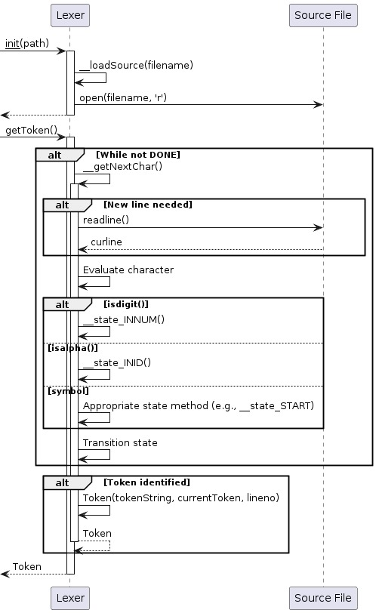
Lexer
The Lexical Analyser employs a state machine mechanism to sequentially process characters.. Each character encountered triggers a transition to a specific state, such as identifying numbers, identifiers, or operators. Special cases like comments, string literals, and logical operators are handled meticulously.
Tokens generated as characters are parsed, with reserved words assigned appropriate with their token types. This systematic approach ensures accurate an effective Lexical Analysis of the Source Code, enabling subsequent phases of parsing to operate effectively.

Slide 9
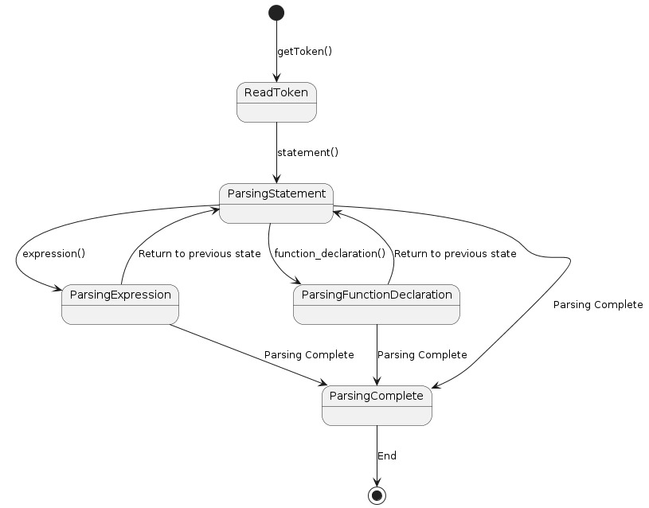
Parser
The Recursive decent Parser implemented comprises a series of methods dedicated to handling various language constructs such as statements, expressions, loops, function declarations, and more. It interacts closely with a lexer and tokenizer allowing it to distinguish between different kinds of nodes in the abstract syntax tree (AST) using an enumeration mechanism, allowing it to accurately represent the hierarchical structure of the source code.
It is also capable of handling complex constructs as if-else blocks, , for loops, while loops, function declarations, and expressions involving operators, identifiers, literals, and function calls. It is also capable of maintaining a function table to keep track of declared functions.

Slide 10
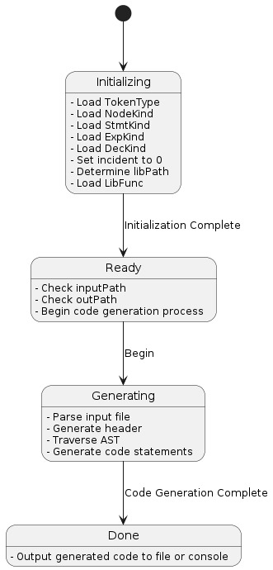
Code Generator
The Code generator proceeds to emit the equivalent Python code for the source MATLAB file, starting with necessary imports and headers. It defines methods to handle different kinds of expressions and statements, recursively traversing the AST.
When encountering expression nodes, it translates MATLAB operators and constructs into their Python equivalents, including handling function calls and special cases like ranges and assignments. It ensures proper indentation and structure in the emitted Python code.
Additionally, it dynamically loads library functions as needed, , by default importing nump, copy, os and sys. The generator systematically converts MATLAB syntax and constructs into equivalent Python code, maintaining proper formatting and structure throughout the translation process.

Slide 11
Overall Flow of the trans-compiler
Mat2py
(.m) file is being compiled
Source file(.m)
Enum.py
Formatted data
Python File(.py)
Tokenizer
Code Generation
Parser
Lexer

Slide 12
Results
The Code Translator works seamlessly as it converts MATLAB files as functional equivalent Python Files retaining the originality of the code, as to be demonstrated in the upcoming slides.

Slide 13
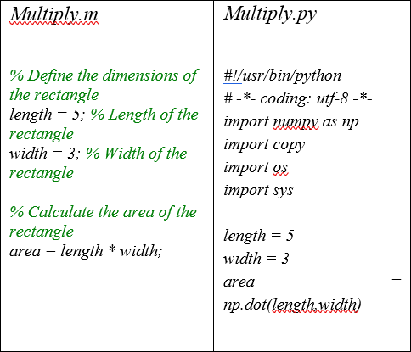
Results : Basic Multiply Function
The Translator is able to handle a simple multiplication code with variables aptly hence proving it works for simple generic codes.

Slide 14
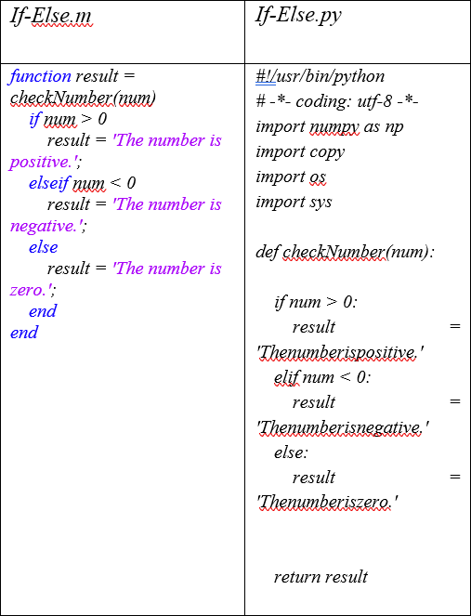
Results : IF – Else Loop
The Translator is able to handle a basic yet challenging If – Else loop consisting of functions and logical operators.

Slide 15
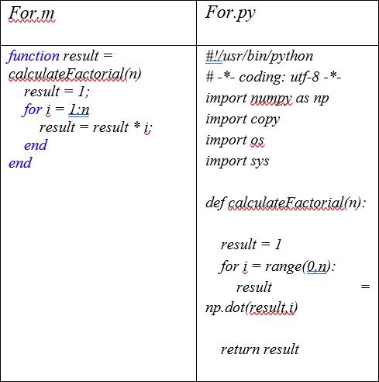
Results : For Loop
The Translator is able to handle a generic For loop consisting of a simple increment counter inside a function ably.

Slide 16

Results : Converter between different units of measure
The Translator is able to handle a large code consisting of multiple functions with loops nested within loops.

Slide 17

Future Scope
The Future Scope for this project is massive and can be narrowed down to two points :
The Translator can be expanded to handle large and complex code basis where functions are spread across multiple files.
The Translator can be expanded to cover multiple other languages

Slide 18
Thank you

